Slide 1




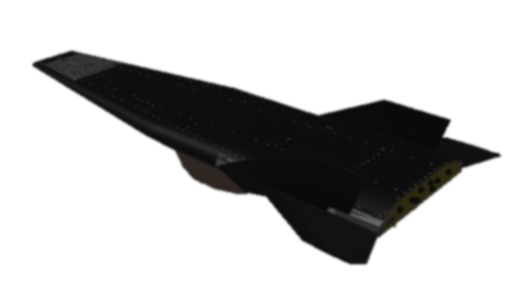

The Cameron Group
Engineering and Technology Innovation
Advanced Systems Engineering and Technology Process Management
Nuclear
Engineering and Space Reactors
Power Technology and Hypersonics
Notes:
Changed:
Added shadow to titles for better definition
Moved subtitle down
Changed middle picture to agree with new name. The image is of the X-43A Hypersonic test vehicle
Need better title

Slide 2


We are a veteran-owned small business…
… of networked, collaborative, science and technology experts and entrepreneurs...
The Cameron Group

Slide 3

The Cameron Group
…many of whom are world-class experts in their field…
Government and industry advisors
Review boards
Safety and licensing panels,
Advanced technology counsel
3

Slide 4






























Headquartered in Silicon Valley
Staff distributed across the U.S. and Japan
Incorporated in 2004, with history back to 1994.

Slide 5
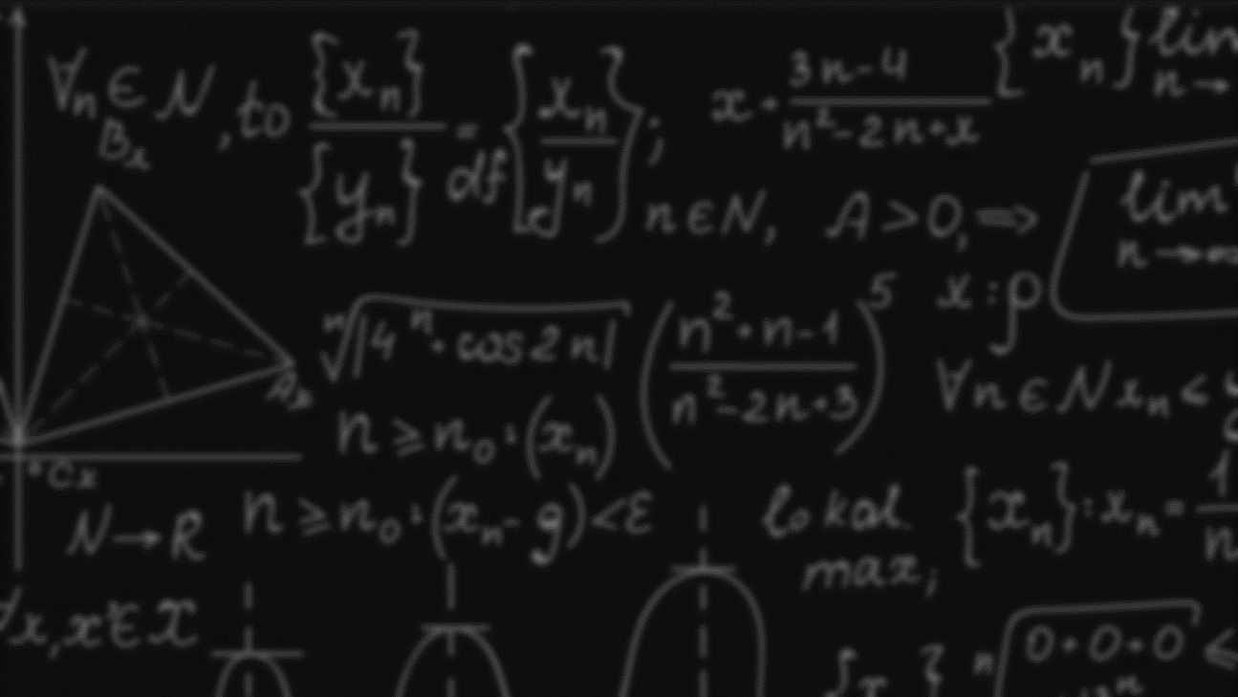




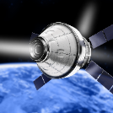
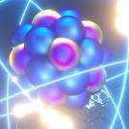

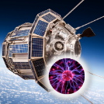
The Cameron Group
Focus Areas Now Supported
Test Reactors
(Idaho Nat. Labs)
Thermionics
(Modern Electron)
Hypersonics and Electron Cooling
Energy
and Lasers
Hall Effect Thrusters (NASA, LM/AJR)
Nuclear
Fuel Recovery
Vehicle Based
Threat Detection
Spacecraft
Nuclear Reactors
Notes:
Changed most of the icons
Not sure about VBTDS icon
There are three “nuclear” ones. Any idea what we can use differently for the second two?

Slide 6
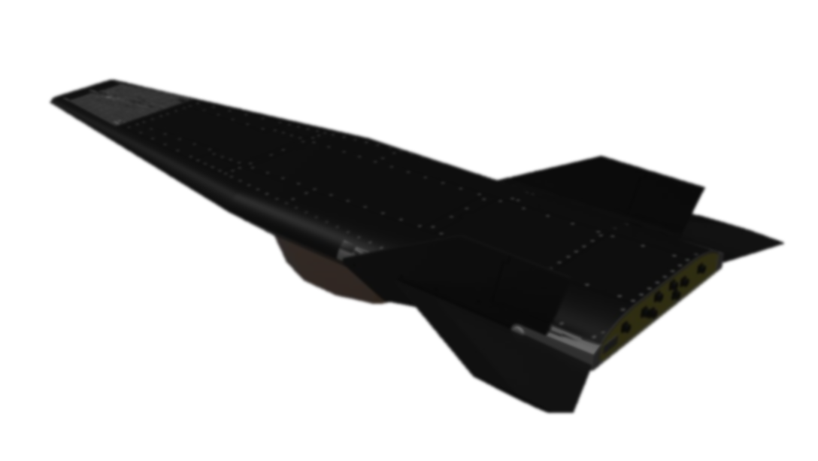

Electron
Transpiration Cooling (ETC)
Projected to remove heat at rates of 500 to 1000 Watts/cm²
Works at very high temperatures, such as leading edges of Hypersonic Vehicles
Passive process: it happens on its own in Graphene with intercalated Cesium atoms

Slide 7
Applications for Hypersonic Vehicles
Electron Transpiration Cooling (ETC)
External cooling
  Emit electrons into plasma
  Collect at cooler rear collector
Internal cooling
  Graphene pulls surface heat internal to preheat fuel.
External cooling
External Protective layer
Jet Fuel Flow
Graphene
Internal cooling
Notes:
Enlarged both images, flipped bottom one horizontally.
Added battery symbol to bottom one to indicate bias.
Changed background image and added the X-43A
Ensure jet exhaust looks good, that is a separate image that I can adjust.

Slide 8
Applications for Hypersonic Vehicles
Electron Transpiration Cooling (ETC)
Reduce friction by pushing plasma away from surfaces
Increase scramjet efficiency
  Transfer energy to combustion
  Compress input plasma
Generate electrical power using heat-removing thermionics
Notes:
Enlarged both images, flipped bottom one horizontally.
Added battery symbol to bottom one to indicate bias.
Changed background image and added the X-43A
Ensure jet exhaust looks good, that is a separate image that I can adjust.

Slide 9
Hypersonic
Plasma Vectoring
Magnetically steer plasma flow away from surfaces, providing directional steering
Notes:
Modified text

Slide 10
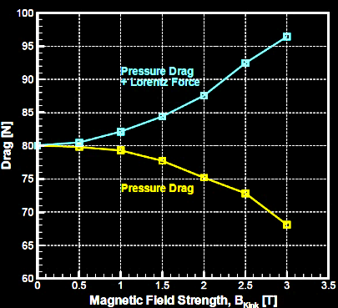
Applications to Hypersonic Vehicles
Hypersonic Plasma Vectoring
Provide maneuverability at high Mach numbers
Reduce friction at leading edges
Increase scramjet efficiency by compressing input plasma
Graph from Nagata, Yamada and Abe, Numerical Investigation of the Electrodynamic Flow Control Around the Double-Cone Configuration, AIAA Aerospace Sciences Meeting including the New Horizons Forum and Aerospace Exposition 4 - 7 January 2011

Slide 11
Electron Polarization
Wave “Laser” (EPWASER*)
Similar to laser, but output is coherent light PLUS coherent electron stream
*Electron Polarization Wave Amplification by the Stimulated Emission of Radiation

Slide 12

EPWASER
Sunlight
Water
Applications
  Compact and efficient solar conversion
    Military Posts
    Habitats in space
    Industrial
    Residential
  Electron beam generator
  High-voltage photovoltaics
  Communications
  New type of laser
EPWASER Water
Splitter
(Space habitats)
H₂
O₂
Storage
Power
Fuel Cell

Slide 13
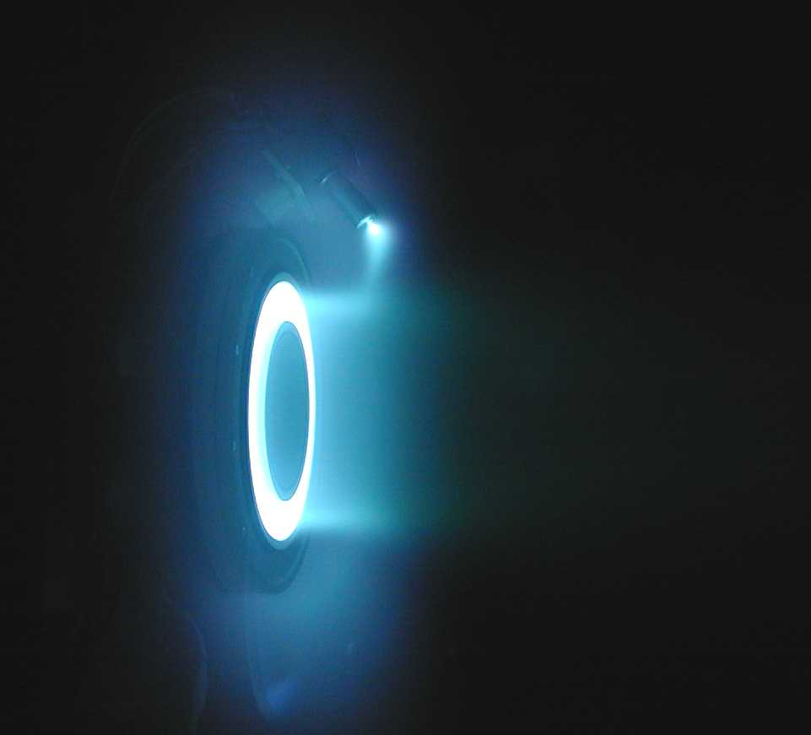
Hall Effect Thrusters
Technology Partnering/Licensing
Hall Effect Thrusters (HETs) are a method of electric propulsion used for in-space maneuvers. HET is a type of plasma rocket, in which a neutralized beam of ions (plus electrons) are electrically accelerated to produce thrust. Common propellants are noble gases, (e.g., Xe⁺ or Kr⁺ etc.)
Propellant mass usage is 5X (or better) than chemical rockets. Thrust is low, so maneuvers are done more slowly than chemical rockets.
Based on newly invented Hall Effect Thrusters (CHETs).
  Supports Orbital Transfer & On orbit station keeping.
CHETS based on Technology and Tradecraft with cumulative ~100 years of specialized expertise in designing and fabricating space systems & CHETS (Cameron HETS)
Notes:
Please provide description, applications, and drawings

Slide 14
Hall Effect Thruster Systems
Technology Partnering/Licensing
HET systems are used for station-keeping and/or orbit-changes in satellites or other spacecraft
Notes:
Please provide description, applications, and drawings

Slide 15
Summary of CHET Advantages
    Shorter Trip Time
    Reduced Fuel Requirements
    Lower Cost
    Multi-mode Agility
    Narrower Plumes
      Reduced Solar Array Impingement

Slide 16
Spacecraft Nuclear Reactors—Desirable Attributes
  Unattended, long-lived operation — with minimal control.
  High temperature reactor thermal power.
  High temperature, high-strength materials.
  Advanced heat transport designs.
  High temperature of heat rejection.

Slide 17
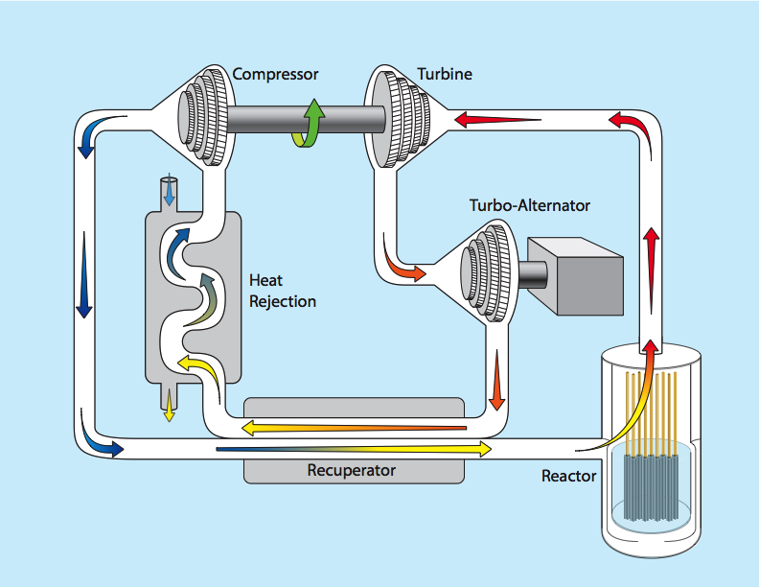
Design Advantages from
Space Reactor Technologies
Compressor
Turbine
Closed Loop
Inert Gas System
with Innovative Nuclear
Reactor Heat Source
Turbo-Generator
Heat Rejection
Differentiators:
-Heat Pipes
-Moderator
-Fuel Cladding
Recuperator
Reactor
- Smaller U²³⁵ Core Loading
- Epi-thermal Fission
- Passive Safety Enhancement
High temp space-age materials and technologies not typically familiar to the terrestrial nuclear community are combined to create improvements in materials capability, U²³⁵ FUEL CONSUMPTION and EFFICIENCY.

Slide 18



The Cameron Group
Call or email:
David Paul
cameronconsults@comcast.net
Phone: 408.621.0337
Fax: 707.521.9460
Advanced Systems Engineering and Technology Process Management
Nuclear
Engineering and Space Reactors
Power Technology and Hypersonics
18
Notes:
What audience do we want to target?
I have made the presumption that it is an audience for partnering/licensing opportunities rather than individual consulting.
That’s RIGHT, an overview of the company, basically, with an introduction to the technologies and focus areas.
Audience is executives who are going to make a decision about supporting a proposal or funding an effort

