Slide 1
Nuclear Engineering
Capabilities
Energy • Engineering • Education • Environment

Slide 2
The Cameron Group
A veteran-owned small business
of networked subject matter experts...
...specializing in Nuclear and Space systems...
...many of whom are world-class
experts in their field.
Operating since 1994, incorporated in 2004,
headquartered in Silicon Valley.

Slide 3
Nuclear Engineering Specialties
Engineering Support & Expert Consulting
Design Review Support
Requirements Management Support
Licensing

Slide 4
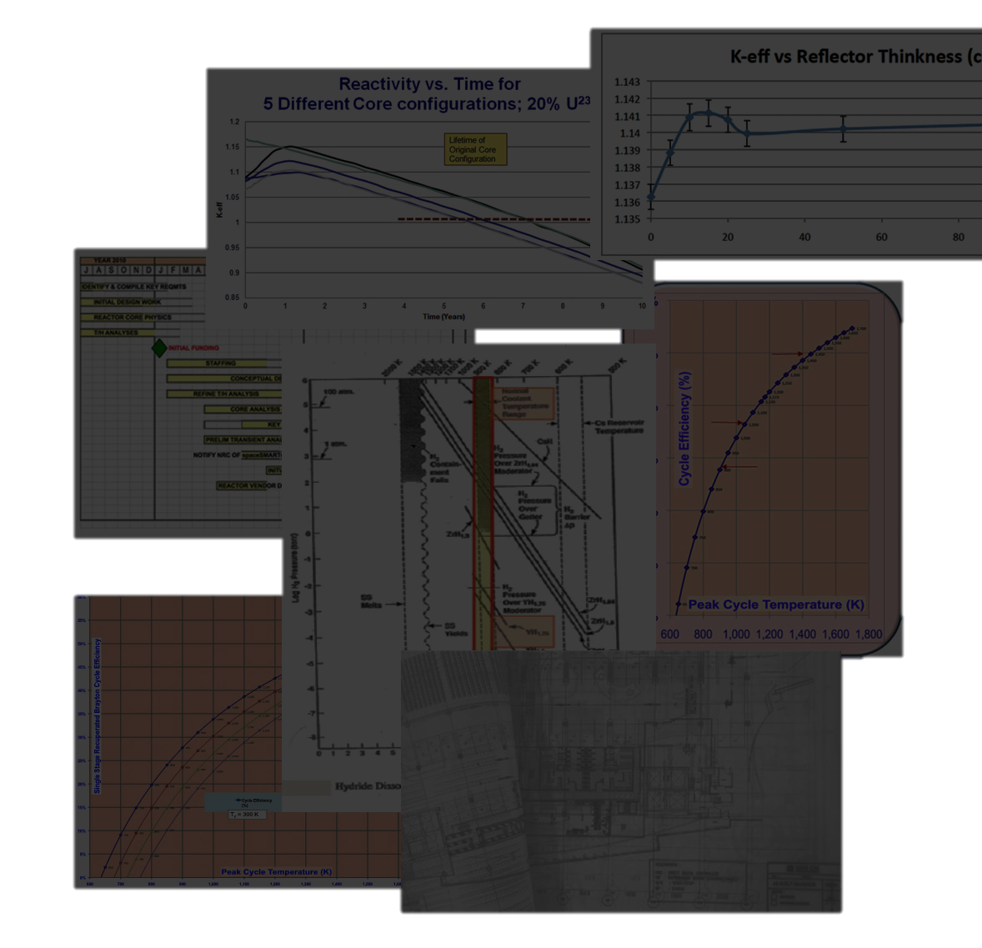
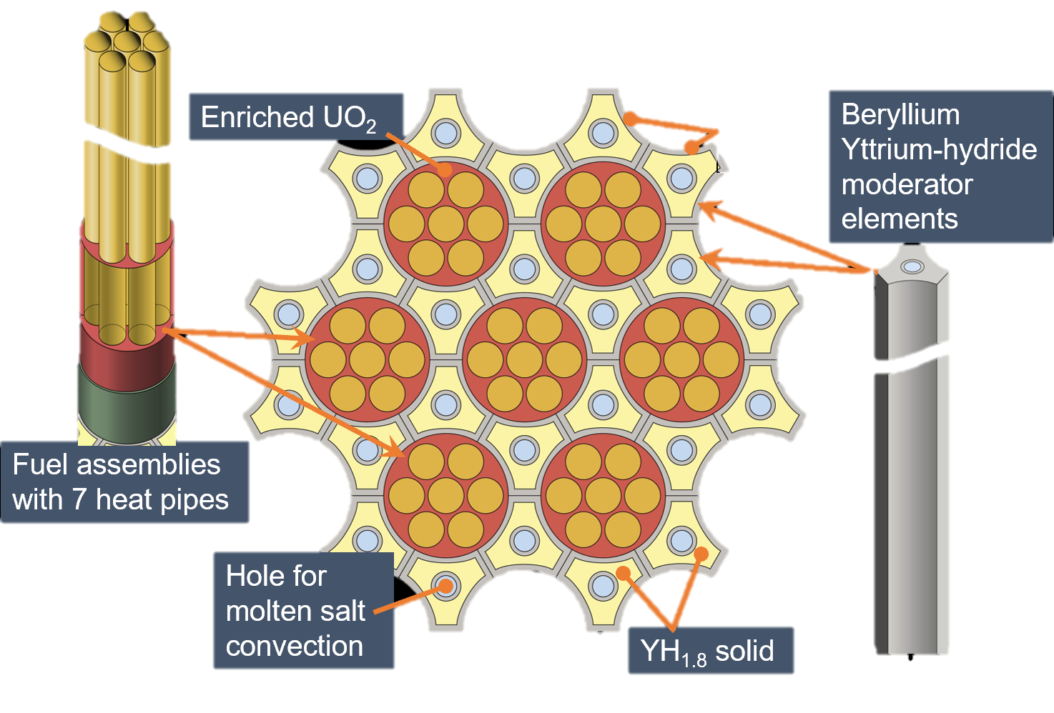

Engineering Support & Expert Consulting
Specialties
Nuclear design/development manpower acquisition
Expert consultant contributions in core physics, analysis, simulation, etc.
Reactor design services
Nuclear plant engineering management
Reactor materials science

Slide 5
Design Review Support
Specialties
Review that requirements cover NRC & IAEA standards
Trace specifications to ensure complete coverage of requirements
Review concepts, plans, and design details
Review development and equipment specifications for complete coverage
Review as-built equipment
Perform/review Safety analysis

Slide 6

Requirements Management Support
Specialties
Implementing requirements management system (RMS)
  Automated, computer-based
  Reduces human error
Customization of RMS database and report formats
Generating System Requirements
Entering requirements & design details at each stage
Dr. Bill Webster
EVP, Business Processes and Systems Engineering
Requirements Generation
Requirements Management
System Architecture
Process Definition

Slide 7
Requirements Management Support (cont’d)
Specialties
Generating Equipment Requirements
Demonstrating 100% traceability coverage through each stage from requirements to as-built
Updating RMS Database to track changes at any stage and reverifying 100% traceability coverage

Slide 8
Licensing
Specialties
Demonstrate design, development and as-built equipment description traceability back to 100 % coverage of standards & requirements
Building license support
Operating license support

Slide 9
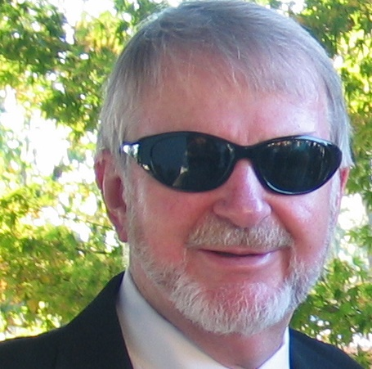

Nuclear Subject Matter Experts
Dr. Ned Britt
Chief Scientist,
CTO
Analytical Research
Nuclear Design
Laboratory Testing
Compact Modular Reactors
High Temperature Materials Technology
Molten Salt Cooling
Advanced Fuel Cladding
Dr. Saleem Drera
VP Nuclear Consulting, Deputy CTO
Nuclear Design
Core Physics
Criticality and Shielding
Design Simulation
Design Analysis
Structural Analysis
Laboratory/Irradiation Design and Testing

Slide 10

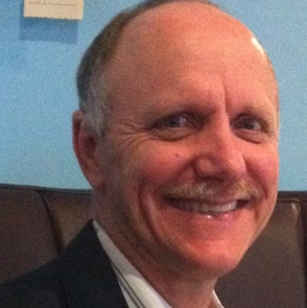
Nuclear Subject Matter Experts (cont’d)
David Blessing
Director, Commercial Nuclear Power Division
Design, Operation, and Maintenance
Technology Assessment
Reactor Maintainability
Complex Systems Evaluation
Development Manager
Small Modular Reactors
Dr. Robert Kenley
Board of Directors
Professor, Purdue University
Programmatic Risk Assessment
Risk Management
Statistical Modelling
Systems Engineering
Nuclear materials stabilization
Business Process Engineering
Life cycle cost

Slide 11
Nuclear Expert Recruiting
In addition to our in-house experts,
we use our nuclear industry contacts
to identify and hire additional top-level experts when needed to meet
clients’ design and development needs.

Slide 12
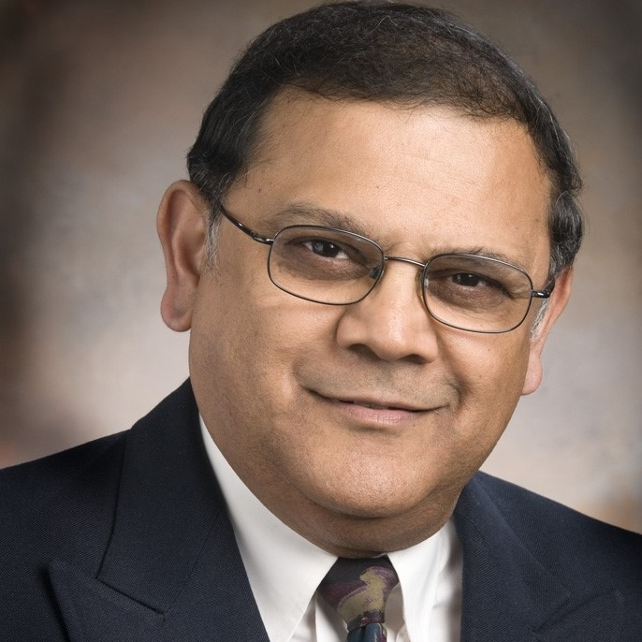


Nuclear Advisors
Dr. Samit Bhattacharyya
Chairman, Board of Directors
Nuclear advisor to NASA, DOE
Former Director, Argonne and Savannah River National Labs
Nuclear physics, safety, design, and engineering
Fast, thermal, and transient reactors
Spent fuel reprocessing
Marion Thompson
Director, Nuclear Fuels Processing
Nuclear safety
Mixed oxide fuel fabrication
Fuel materials and processing
Fuel chemical processing
Plutonium
Robert Wohl
Nuclear Consulting
Nuclear Operations
US Navy, PG&E, EPRI
Nuclear technology management
Plant technical issue resolution
Operations and maintenance

Slide 13
Our Mission
We are dedicated to applying our insight, experience, and expertise to help our clients transform and improve the world’s condition.
We want your organization to accomplish its goals.
That’s our mission.

Slide 14
Energy • Engineering • Education • Environment
Call or email:
David Paul
cameronconsults@comcast.net
Phone: 408.621.0337
Fax: 707.521.9460

Slide 15
Supplemental Material

Slide 16
Dr. Ned Britt
BS, Engineering Physics, University of Arizona; Ph.D., Nuclear Engineering, University of Arizona.
Dr. Britt has over 40 years experience in analytical research, engineering design, laboratory testing, and R&D management
Some areas of research and development have included space nuclear reactor systems, thermionic energy conversion, low energy plasma physics, laser concepts, and various other aspects of space power, propulsion and weapons detection.
Dr. Britt is a co-founder of several research corporations including Cameron Technology Development Company, Rasor Associates, Inc; Space Power, Inc; International Scientific Products, and Russian- American Joint Stock Company INERTEK.
Dr Britt was President and CEO of Space Power, Inc. when it was acquired by Pratt & Whitney Space Propulsion Division of United Technologies Corp.

Slide 17
Dr. Saleem Drera
PhD Nuclear Engineering, Colorado School of Mines. BS Nuclear Engineering, BS Chemical Engineering, UC Berkley. MS, Mechanical Engineering, University of Colorado.
Dr. Drera’s expertise lies in irradiation deign and testing, medical isotope production, computational and non-computational reactor core and particle physics for criticality, shielding, and design applications. This includes advanced computational skills in Nuclear Monte Carlo, Point Depletion, etc. (MCNP, SCALE, etc.); mechanical CAD (SolidWorks, ProE); CFD, FEA / stress analysis (Cosmos, Abaqus); Chemical: ASPEN; MATLAB simulation; Fortran, C++ and Java programming.
His previous and current experience includes RadTran, Idaho National Lab (via consultant contract), Thor Energy (via consultant contract), Argonne National Lab (doctoral thesis assignment) Knolls Atomic Power Laboratory – Lockheed Martin, and the Electric Power Research Institute.

Slide 18
David Blessing
David Blessing is an expert in developing nuclear plant designs from initial concepts through to final engineering drawings, including overall integration of complex mechanical and electrical systems and directing efforts of teams of specialists. He is also an expert in nuclear waste forms, waste standards, and in the design and operation of contaminated nuclear systems.
He managed the Lockheed Martin team supporting GE-Hitachi developing the PRISM reactor under DOE’s Global Nuclear Energy Partnership program, and led the Lockheed Martin reactor team in developing the conceptual design of the lithium cooled fast reactor module for the Jupiter Icy Moons Orbiter (JIMO) for NASA-JPL.
Prior to his time at Lockheed Martin, he was a Nuclear Power Engineer in the Navy’s Division of Naval Reactors, leading over one hundred engineers and personnel from multiple contractor and government organizations to assess advanced technologies for propulsion plants for nuclear submarines.
Mr. Blessing received his MS Mechanical Engineering (fluid dynamics) from the Naval Postgraduate school, BS Physics and Phi Beta Kappa from the University of Washington, and Bettis Reactor Engineering School.

Slide 19
Dr. Robert Kenley
Ph.D., Engineering-Economic Systems (EES), Stanford University; M.S., EES, Stanford University; M.S., Statistics, Purdue University; S.B., Management, Massachusetts Institute of Technology
Dr. Kenley has extended experience in statistical modelling and analysis methods for evaluating and forecasting nuclear program risk, cost, life cycle cost, and nuclear materials stabilization. This includes Monte Carlo analysis, cost-based Value Engineering (VE), and using VE to analyze task alternatives for enterprise architecture trade-offs.
Dr. Kenley has frequently supplied expertise in Value Engineering methods, risk analysis, modeling, analysis, and using statistical methods to help evolve the Enterprise Architecture Study. This includes the selection of optimal tasks, the entry and exit criteria for these tasks, and the risks associated with each such work product element.

Slide 20
Dr. Samit Bhattacharyya
Dr. Bhattacharyya is President of RENMAR Enterprises, Inc, a Technical and Management Consulting Services Company, serving a broad portfolio of government and private sector clients in the area of advanced nuclear technology and applications.
Currently, he is an Advisor to NASA on its Space Nuclear power and propulsion activities, and to the USDOE on several projects; and formerly, Director of the Technology Development Division at Argonne National Laboratory and a Director of Savannah River National Laboratory.
His expertise includes Nuclear Power Technology (Physics, Safety, Design and Engineering) and deployment strategies; fast, thermal and transient reactors; space nuclear power and propulsion technologies; and deployment strategies.
He is an expert in spent fuel management, reprocessing, stable waste form development, decommissioning and decontamination technologies.
Also, and expert in reduced enrichment research and test reactor technologies; fusion technologies; laser processing and applications; aerosol technologies and advanced simulation and modeling.

Slide 21

Marion Thompson
Mr. Thompson has 37 years management and technical experience with the General Electric Company in nuclear safety, mixed oxide (MOX) fuel fabrication, fuel materials and process research and development, chemical processing, mechanical engineering and plutonium facility startup, operation and decommissioning.
His expertise includes technical and economic evaluation of fuel cycles and process systems and performance of systems engineering to achieve quality production and reliability. He performed fuel cycle assessment and economic evaluations of oxide and metal fuel, actinide recycle, excess weapons plutonium disposition, and plutonium and enriched uranium reactor cores.
He has extensive experience with proposals, specifications, procedures, program management and interfacing with customers

Slide 22
Robert Wohl
Bob Wohl was previously Cameron’s VP of nuclear operations, and directed Cameron’s business development.
He served as the Nuclear Regional Manager for the Electric Power Research Institute (EPRI), where he assisted eighteen nuclear plants with their use of EPRI nuclear technology and helped resolve plant technical issues.
Previously, Bob was with Pacific Gas & Electric Company for 13 years in Nuclear Power Generation, responsible for supporting operations and maintenance activities at Diablo Canyon Power Plant in San Luis Obispo.
Prior to joining PG&E, Bob served in the United States Navy and retired with 24 years of service having spent most of his career as a submarine officer. He overhauled two attack submarines and made 16 operational patrols during his career on attack and ballistic missile submarines out of Hawaii.
Bob graduated from Notre Dame University with a BS in Electrical Engineering and resides in Alamo California.

Slide 23
Dr. Bill Webster
Ph.D., Electrical Engineering, Cornell University. Leads the Requirements Management and Business Processes Consulting Team for Cameron clients' programs, providing Process Definition, Requirements Generation, current solutions, toolsets, Requirements Management, training.
C-Level Executive with previous roles as Vice President, Engineering – Litton, Vice President – Vice President, NetConvergence, President, The Creative Group, Inc. (TCGI). For Areva Solar, world-leader in large (250MW) solar facilities, delivered 30 processes, metrics, training in Engineering and Supply Chain Management. Skilled in Sarbanes Oxley audits.
Team Leader in Program Management, Process Definition, Requirements Management, Traceability and Completeness for enhancing technical and business operations, Systems Architecture and algorithm development.
Started TCGI, created & deployed 30 Weather Radar / Satellite Stations, world-wide, developed Ephemeris fast-calculation equations / SW for Satellite Tracking using just a Mini-computer. Conceived, designed, prototyped original Terrain-Following Radar now on all Combat Aircraft / Tanks

